Slide 1
Lobster Data Collection
Jeremy Prince
January 2021

Slide 2
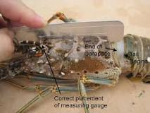
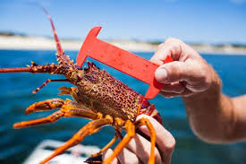

Slide 3
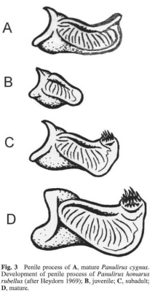
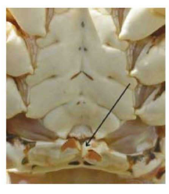

From: George, R.W. (2005) Comparative morphology and evolution of thereproductive structures in spiny lobsters, Panulirus , New Zealand Journal of Marine and Freshwater Research, 39:3, 493-501, DOI: 10.1080/00288330.2005.9517328

Slide 4
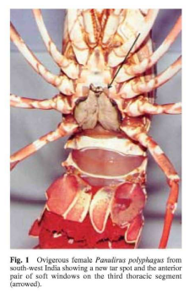
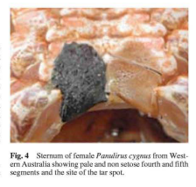
From: George, R.W. (2005) Comparative morphology and evolution of thereproductive structures in spiny lobsters, Panulirus , New Zealand Journal of Marine and Freshwater Research, 39:3, 493-501, DOI: 10.1080/00288330.2005.9517328

Slide 5
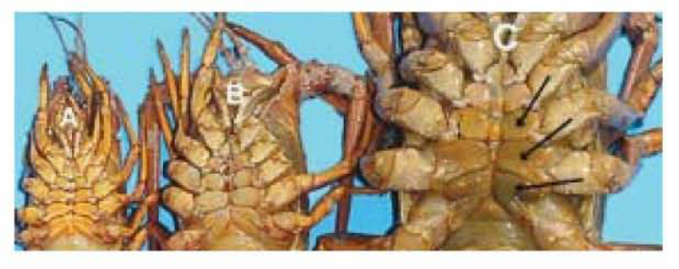
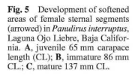
From: George, R.W. (2005) Comparative morphology and evolution of thereproductive structures in spiny lobsters, Panulirus , New Zealand Journal of Marine and Freshwater Research, 39:3, 493-501, DOI: 10.1080/00288330.2005.9517328

Slide 6
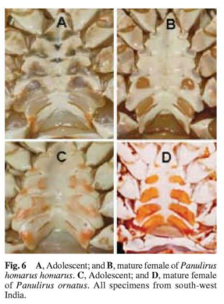
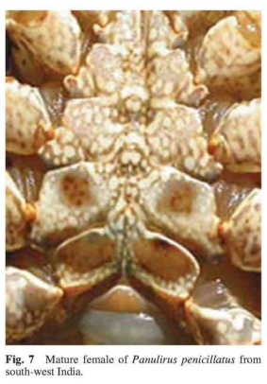
From: George, R.W. (2005) Comparative morphology and evolution of thereproductive structures in spiny lobsters, Panulirus , New Zealand Journal of Marine and Freshwater Research, 39:3, 493-501, DOI: 10.1080/00288330.2005.9517328

Slide 7
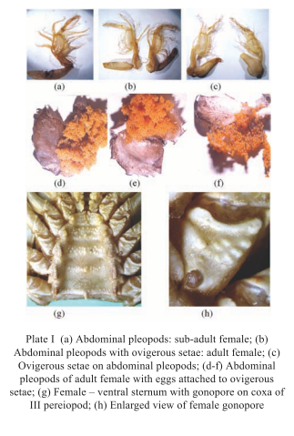
From: George, R.W. (2005) Comparative morphology and evolution of thereproductive structures in spiny lobsters, Panulirus , New Zealand Journal of Marine and Freshwater Research, 39:3, 493-501, DOI: 10.1080/00288330.2005.9517328

Slide 8
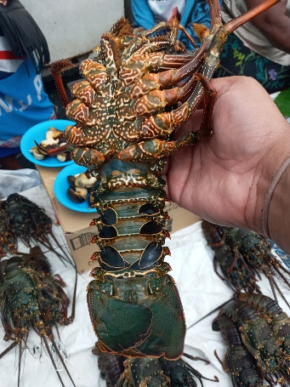
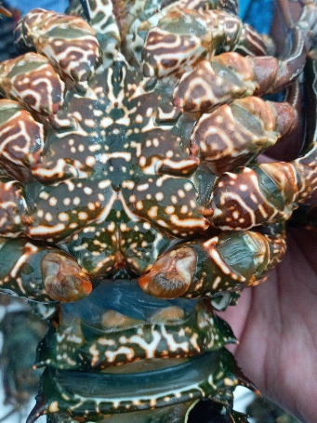
Panulirus pencilatus
Adult Male
Penile Processes

Slide 9
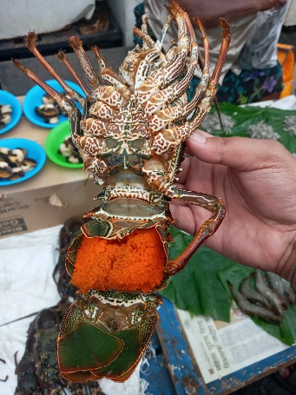
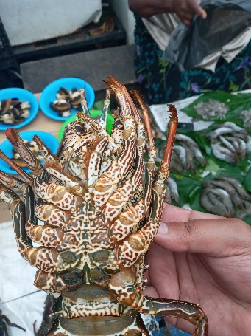
Panulirus pencilatus
Adult Female
Egg mass
Softened window
Remains of tarspot

Slide 10
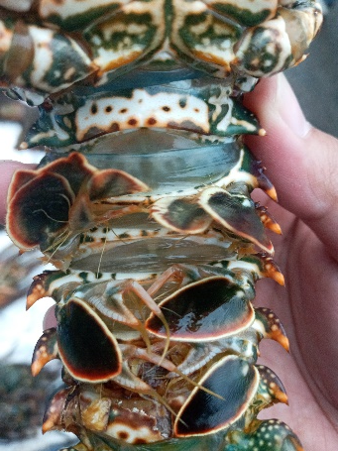
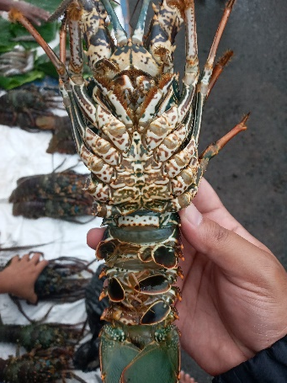
Panulirus pencilatus
Immature Female
No softened windows
Setose (hairy) pleopods for holding eggs

Slide 11
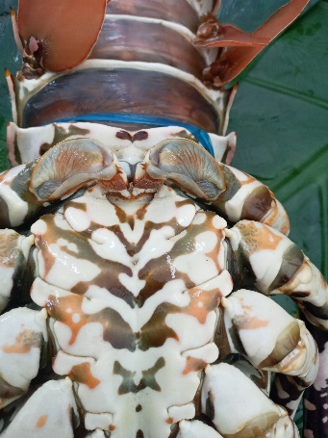
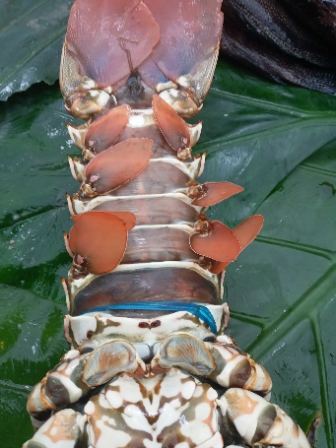
Panulirus ornatus
Adult Male
Penile Processes

Slide 12
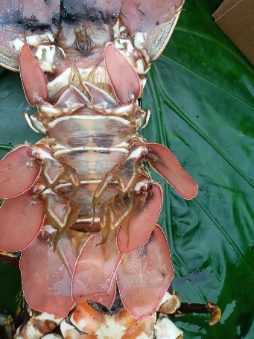
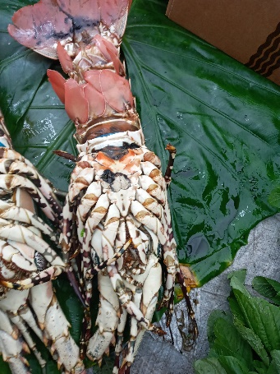
Panulirus ornatus
Adult Female
Soft windows
Remains of tarspot
Soft windows

Slide 13
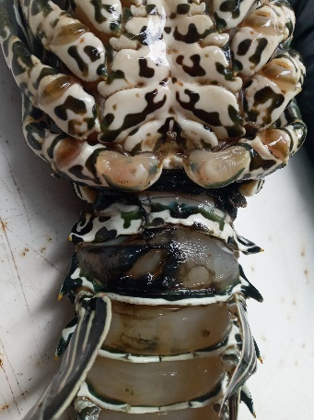
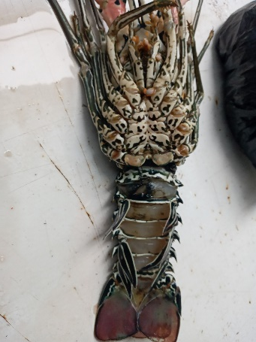
Panulirus versicolor
Adult Male
Penile Processes

Slide 14
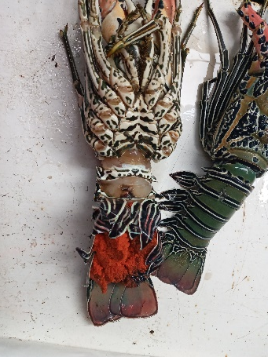
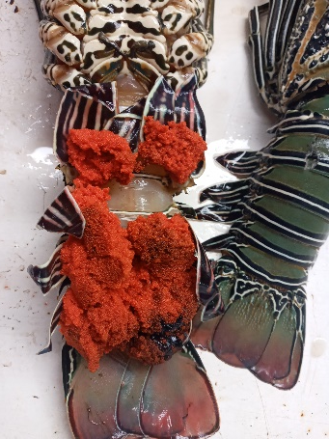
Panulirus versicolor
Adult Female
Softened Window
(not clear)
Egg Mass

Slide 15
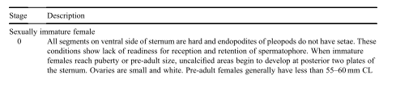
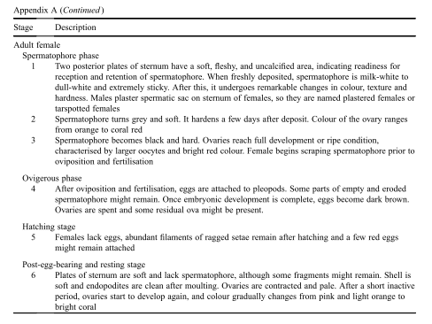
From: George, R.W. (2005) Comparative morphology and evolution of thereproductive structures in spiny lobsters, Panulirus , New Zealand Journal of Marine and Freshwater Research, 39:3, 493-501, DOI: 10.1080/00288330.2005.9517328

Slide 16
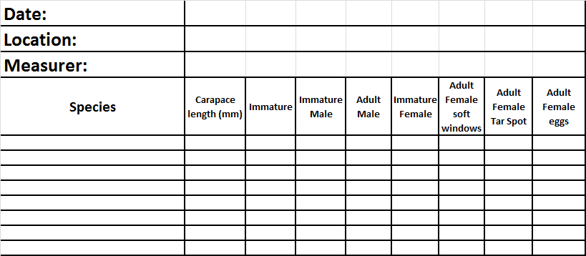
Data Collection Sheet Template

Slide 17
Example of Data Collection

Slide 18
Data Collection Protocols
Lobster Data Collection.
1. Carapace length – Measure in mm from front of carapace behind the eyes to rear edge of the carapace.
2. Immature – Underside of carapace (the sternum) has no obvious sexual features (no soft windows, tarspot or penile processes and the pleopods (swimming fins on both sides under the tail) have no endopodites (small inside fins for holding eggs).
3. Immature Male – Small penile processes are developing at the back of the sternum, and the pleopods (swimming fins under the tail) and the pleopods (swimming fins under the tail) have no endopodites (small inside fin for holding eggs).
4. Adult Male – Penile process has grown to full size and the pleopods (swimming fins under the tail) have no endopodites (small inside fin for holding eggs).
5. Immature Female – Soft windows (darker or less colored patches) developing and the pleopods (swimming fins under the tail) have endopodites (small inside fin for holding eggs) but the endopodites have little or no hairy covering (setae).
6. Adult Female (Any of the following characteristics):
  a. Fully developed soft windows (darker or less colored patches) are obvious near the rear of the sternum, endopodites inside the pleopods (swimming fins) may or may not be hairy (have setae).
  b. Tarspot at the rear of the sternum showing mating has occurred, normally the endopodites will now have a hairy covering (setae) ready for the eggs to be attached and fertilized.
  c. Berried female carrying eggs under the tail, there may also be some remnant of a tarspot still in place, and soft windows (darker or less colored patches) should be visible on the sternum.

